Slide 1

Introduction to TCP/IP Protocols
Chapter 4
420-A32 Networks

Slide 2
Protocols
The rules and procedures for communicating
For two computers to communicate, they must speak the same language and agree on the rules of communication
Protocols can refer to a group of individual protocols that work together to accomplish:
data translation
data handling
error checking
addressing

Slide 3
The Function of Protocols
As protocols serve their functions in the OSI model, they might work at one or many layers
When a set of protocols works cooperatively, it’s called a protocol stack or protocol suite
The most common protocol stack is TCP/IP, the Internet protocol suite
Levels of a protocol stack map to their functions in the OSI model

Slide 4
Connectionless Vs Connection-Oriented
Connectionless delivery place data on the network and assume it will get through
Connectionless protocols not entirely reliable
Are fast: little overhead, don’t waste time establishing/managing/tearing down connections
Example: UDP
Connection-oriented protocols are more reliable and slower
Two computers establish a connection before data transfer begins
Ensures that all data is received and is accurate, or that suitable error messages are generated
Example: TCP
Notes:
In a connection, data is sent in an orderly fashion

Slide 5
Routable Versus Nonroutable Protocols
The network layer (OSI) is responsible for moving data across multiple networks
Routers are responsible for routing process
Protocol suites that function at Network layer are routable or routed protocols; otherwise, they are called nonroutable
TCP/IP is a routable protocol
An older and nearly obsolete protocol, NetBEUI, is a nonroutable protocol that works well in small networks, but its performance drops considerably as a network grows

Slide 6
Protocols in a Layered Architecture

Slide 7
Protocols in a Layered Architecture

Slide 8
Network Protocols
Some popular network protocols include:
Internetwork Packet Exchange (IPX)
Novell’s protocol for packet routing and forwarding
Belongs to the IPX/SPX protocol suite
Serves many of the same functions as TCP/IP’s IP
Internet Protocol version 4 (IPv4)
Provides addressing and routing information
Internet Protocol version 6 (IPv6)
A new version of IP that’s being implemented on many current networking devices and operating systems
Notes:
Network protocols provide addressing and routing information, error checking, retransmission requests and rules for communicating in a network.
Called link services and we’ll talk more about them later.
IPv6 addresses problems with the IPv4 limitations

Slide 9
Transport Protocols
Either connection-oriented (reliable) or connectionless (best-effort) delivery
Sequential Packet Exchange (SPX)
Novell’s connection-oriented protocol used to guarantee data delivery
NetBIOS/NetBEUI
NetBIOS establishes/manages communications between computers and provides naming services
NetBEUI provides data transport services for these communications
Transmission Control Protocol (TCP)
Responsible for reliable data delivery in TCP/IP
Notes:
Handle data delivery between computers.

Slide 10
Application Protocols
Provide services to client applications
Telnet in TCP/IP
DHCP in TCP/IP
HTTP in TCP/IP
Simple Mail Transport Protocol (SMTP) in TCP/IP
File Transfer Protocol (FTP) in TCP/IP
Simple Network Management Protocol (SNMP)
Manages and monitors network devices (TCP/IP)
Notes:
Operate at the upper layers of the ISI model and provide services to client applications
SMTP – transferring email
FTP – transferring files
SNMP – manage and monitor network devices

Slide 11
Common Protocol Suites
Because most protocols contain a combination of components, these components are usually bundled as a protocol suite
TCP/IP
IPX/SPX
AppleTalk
TCP/IP is the most popular protocol because it is:
Low cost
Platform independent
Routable
Notes:
Most protocols contain a combination of components to make communications work correctly
The components are bundled into protocol suites
These are the most common, although TCP/IP dominates the networking arena to the point of making most of the other suites nearly obsolete

Slide 12
TCP/IP
Notes:
The most common protocol suite
Basis for the Internet
Started when adapted by Unix as its protocol
Scalability and superior functionality made it a standard when connecting different kinds of networks
Actually older than the OSI model, but matches up as in this diagram

Slide 13
TCP/IP Network Layer Protocols
IPv4 is a Network layer protocol that provides source and destination addressing and routing for the TCP/IP suite
Connectionless protocol; fast but unreliable
Internet Control Message Protocol (ICMP) used to send error and control messages between systems or devices
Address Resolution Protocol (ARP) resolves logical (IP) addresses to physical (MAC) addresses
Notes:
More highly compartmentalized than other protocol suites
ICMP – The Ping utility uses ICMP to request a response from a remote host to verify availability for communications
ARP can only occur if machines are on the same network
- Sends an arp request with the IP address to get the MAC address of the physical device thus allowing data link layer to send the frame correctly.

Slide 14
TCP/IP Transport Layer Protocols
Transmission Control Protocol (TCP) is the primary Internet transport protocol
Connection oriented using a three-way handshake
Message fragmentation and reassembly
Uses acknowledgements to ensure that all data was received and to provide flow control
User Datagram Protocol (UDP) is connectionless
Generally faster, although less reliable, than TCP
Doesn’t segment data or reorder packets
Doesn’t use acknowledgements for reliability
Used by NFS and DNS
Notes:
TCP accepts messages of any length from upper layer and provides transportation to a TCP peer on another network station
3-way handshake – computer initiating conversation sends a special packet to the destination saying that it wants to create a connection
Destination responds with a positive acknowledgement
Initiator sends its own ack and the connection is established
TCP uses port addresses to determine for which connection a packet is destined
UDP is different and not as widely used

Slide 15
TCP/IP Application Layer Protocols
Domain Name System (DNS)
Session layer name-to-address resolution protocol
Hypertext Transport Protocol (HTTP)
To transfer Web pages from Web server to browser
File Transfer Protocol (FTP)
For file transfer and directory and file manipulation
Telnet
Remote terminal emulation
Simple Mail Transport Protocol (SMTP)
Provides messaging services
Notes:
DNS operates at Session layer of OSI model
- list of server names and their IP addresses, use names rather than address
- when type www.google.com browser contacts DNS function on your computer which contacts a DNS server
Telnet for monitoring remote equipment or logging on to dissimilar system although other techniques are replacing it
A lot of other protocols mostly specialized ones that exist and we’ll talk about them later in the course
- Need to understand IP addressing to really understand networks

Slide 16
More About TCP
Provides reliable data delivery services
Connection-oriented
Establish connection before transmitting data
Connection established using an acknowledgement mechanism
Sequencing and checksums provide the reliability
Flow control ensures that data does not flood node, using a sliding window mechanism
All info is encapsulated in a TCP header

Slide 17
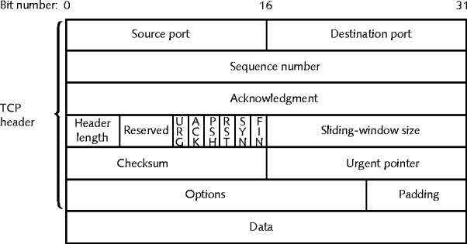
TCP Header
Figure 4-1 A TCP segment

Slide 18
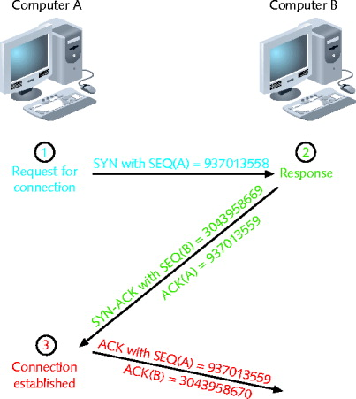
TCP Connection Establishment

Slide 19
TCP Connection Establishment
Computer A issues message to Computer B
Sends segment
SYN field: Random synchronize sequence number
Computer B receives message
Sends segment
ACK field: sequence number Computer A sent plus 1
SYN field: Computer B random number
Computer A responds
Sends segment
ACK field: sequence number Computer B sent plus 1
SYN field: Computer B random number

Slide 20
UDP
Provides unreliable data delivery services
Connectionless transport service
No assurance packets received in correct sequence
No guarantee packets received at all
No error checking, sequencing
Lacks sophistication, but is more efficient than TCP
Useful when a large volume of data needs to be transferred quickly

Slide 21
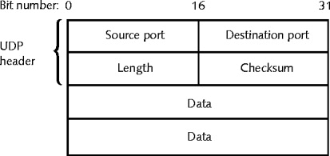
UDP Header

Slide 22
IP
IP is an unreliable, connectionless protocol.
There is no guaranteed data delivery.
IP is used by higher level protocols to ensure data packets are delivered to the correct addresses.
IP is all about addressing…
IP header contains source and destination IP address
The addressing allows internetworking - traverse more than one LAN segment
IP has a small reliability component by using a header checksum which verifies routing information integrity in the IP header.

Slide 23
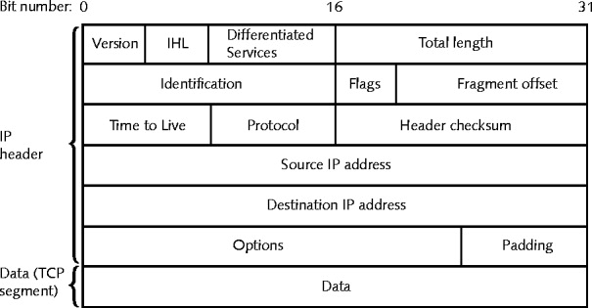
IP Header

Slide 24
ICMP
ICMP reports on data delivery success/failure
Ping is an example of an ICMP packet
ICMP is used to detect transmission failures and report them to the sender. It is used to detect:
Network congestion
Data that fails to reach the destination
ICMP cannot correct errors, it can only detect them.
Provides critical network troubleshooting information

Slide 25
ARP (Address Resolution Protocol)
ARP obtains the host MAC (physical) address
Creates database that maps the MAC address to the host’s IP (logical) address
The ARP table (ARP cache) is the name of this database
Stored on computers hard drive
Contains recognized MAC-to-IP address mappings
The ARP table increases efficiency by storing mappings locally, and only needing to request the mapping over the network when the address is not in the ARP cache.

Slide 26
ARP
The ARP cache contains two types of entries:
Dynamic entries, which are created when a client makes an ARP request that cannot be satisfied by data in ARP table
Static entries, which are entries entered manually using an ARP utility program.
ARP utility program is accessed via the arp command in both Windows and Linux.
Provides ARP table information
Provides way to manipulate device’s ARP table

Slide 27
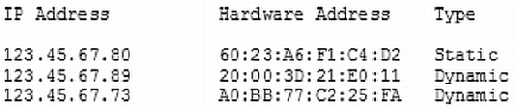
Sample ARP Cache

Slide 28
IP, ICMP, and ARP in Action
Notes:
Let’s see how they work together to accomplish communication
Before A can send a message to B it needs to have the IP and the MAC address of Computer B
MAC needed so when computer receives the frame it will know that the message is for it and accept it and read the frame
Information is passed to next layer (Network Layer) for further processing
Network layer verifies that the IP address matches
Mail analogy
MAC address is street address
Name of the person living in the house can change
When a letter comes in you check to see if it is addressed to you, or you reject it
When sending a letter you may have someone’s name but not their street address. You look it up in an address book
The address book is ARP…
A wants to ping B it pings the IP, network layer sends out an arp request, B replies with MAC Address matching the IP address
A adds that to the address and sends the message

Slide 29
IP, ICMP, and ARP in Action
Notes:
Internet Control Message protocol message
Add the IP information
Add the MAC addresses at the data link layer

Slide 30
RARP
Problem: If a device does not know its own IP address then it cannot use ARP.
Solution: RARP - (Reverse Address Resolution Protocol)
Client sends broadcast message with MAC address and receives the IP address in reply.
RARP server maintains a table which contains MAC addresses and their associated IP addresses.
RARP was originally developed for diskless workstations.

Slide 31
IP Address assignment

Slide 32
Assigning IP Addresses
Several different government-sponsored organizations assign IP addresses to ISPs and network providers.
IANA, ICANN, RIRs
Most companies and individuals obtain their IP addresses from ISPs.
Every network node must have a unique IP address
Error message otherwise

Slide 33
Assigning IP Addresses
IP addresses can be assigned in one of two ways:
Static IP address
Assigned manually by a person
Done by modifying client workstation TCP/IP properties
Can result in duplicate addresses due to human error
Automatic IP addressing
Application assigns the address
BOOTP (obsolete) and DHCP
Reduce chance of duplicate IP address error

Slide 34
DHCP
DHCP = Dynamic Host Configuration Protocol
Application layer protocol developed by IETF
Automatically assigns a network device a unique IP address
Reduces chance of duplicate IP addresses
Allows users to move their network devices without having to change their TCP/IP configuration
Makes IP addressing transparent for mobile users
Requires DHCP service on DHCP server

Slide 35
DHCP Leasing Process
With DHCP, device borrows (leases) an IP address
Devices use IP address temporarily for a specified time limit
Lease time
Determined when client obtains IP address at log on
User may force lease termination
DHCP service configuration
Specify leased address range
Configure lease duration
Several steps to negotiate client’s first lease

Slide 36
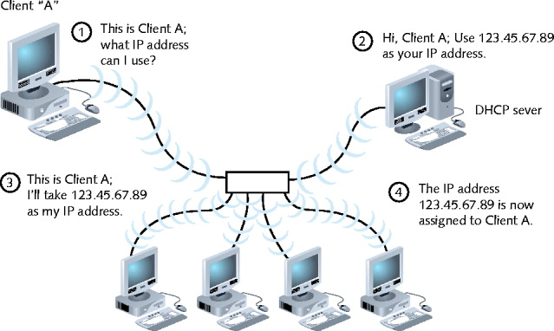
DHCP Leasing Process

Slide 37
Terminating a DHCP Lease
A DHCP lease may expire for one of two reasons:
Automatic expiration (time up)
Established in server configuration
Manually terminated at any time
Client’s TCP/IP configuration
Server’s DHCP configuration
Circumstances requiring lease termination
DHCP server fails and replaced
Windows: release of TCP/IP settings
DHCP services run on several server types
Installation and configurations vary

Slide 38
APIPA
APIPA = Automatic Private IP Addressing
Supported only by Windows
APIPA allows assignment of an IP address even when a DHCP server is not running.
Provides IP address automatically
APIPA assigns an IP address from predefined pool of addresses, which are reserved for this purpose.
169.254.0.0 through 169.254.255.255
Disadvantage of APIPA:
A computer can only communicate with other nodes using addresses in APIPA range.

Slide 39
PORTs and sockets

Slide 40
Sockets and Ports
Just as a device requires a unique address to send and receive information over a network, processes also require a unique address.
Every process is assigned a unique port number
Ports simplify TCP/IP communications and ensure data is transmitted correctly
Process’s socket is a port number plus host machine’s IP address
Example:
Telnet port number: 23
IPv4 host address: 10.43.3.87
Socket address: 10.43.3.87:23

Slide 41
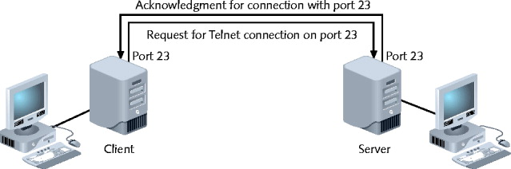
Virtual Connection for Telnet Service

Slide 42
Sockets and Ports
Port numbers range from 0 to 65535
Three types of ports:
Well Known Ports
Range: 0 to 1023
Operating system or administrator use
Registered Ports
Range: 1024 to 49151
Network users, processes with no special privileges
Dynamic and/or Private Ports
Range: 49152 through 65535
No restrictions

Slide 43
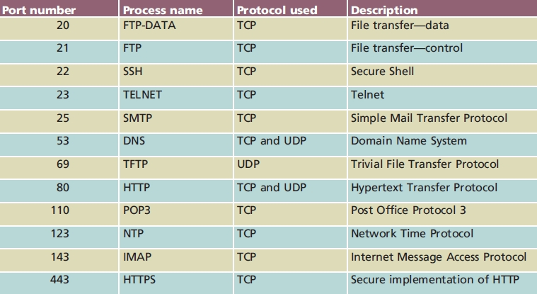
Commonly Used TCP/IP Port Numbers

Slide 44
Host names and DNS

Slide 45
Host Names
TCP/IP addressing uses long, complicated numbers, which are good for computers, not so good for people.
People remember words better, so Internet authorities established an Internet node naming system based on words, rather than numbers.
Host = any Internet device
Host name = name describing the device.
Example: My PC may have the IP address 135.55.78.109 but can be referred to by its host name sandras_pc

Slide 46
Domain Names
A domain is a group of computers belonging to the same organization and has part of their IP address in common.
Domain name identifies the domain.
Associated with company, school, government organization
i.e. heritage.qc.ca
Fully qualified host name is the local host name plus domain name.
sandras_pc.heritage.qc.ca

Slide 47
Domain Names
A domain name is represented by a series of characters called labels.
Each label is separated by a dot
Represents level in domain naming hierarchy
Example: www.google.com
Top-level domain (TLD): com
Second-level domain: google
Third-level domain: www
Second-level domain
May contain multiple third-level domains

Slide 48
Host Files
Host file is a file that associates host names with IP addresses.
Linux-based computer
Host file called hosts, located in the /etc directory
Windows computer
Host file called hosts, located in %systemroot%\system32\drivers\etc folder
Not suitable for large organizations

Slide 49
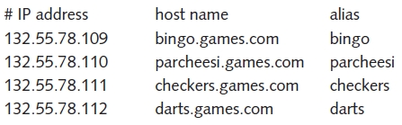
Sample Host File

Slide 50
DNS
DNS = Domain Name System
DNS is a hierarchical way to associate domain names with IP addresses.
DNS refers to both the:
Application layer service accomplishing association
Organized system of computers and databases making the association possible
Relies on many computers across globe related in hierarchical manner, rather than just one host file.
This provides redundancy
Root servers - 13 computers (ultimate authorities)

Slide 51
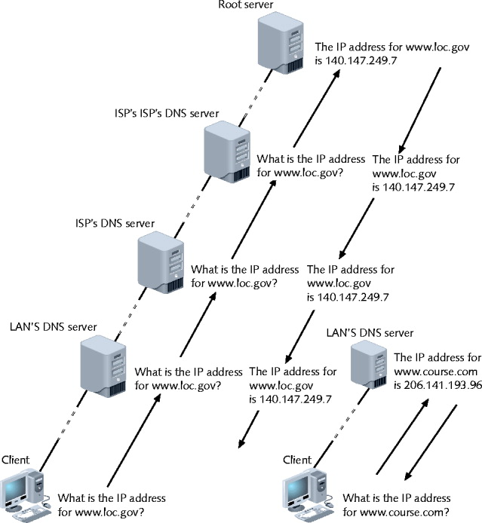
Domain Name Resolution

Slide 52
DNS
DNS is divided into three components:
Resolvers
Any hosts on Internet needing to look up domain name information
Name servers (DNS servers)
Databases of associated names, IP addresses
Provide information to resolvers on request
Namespace
Abstract database of Internet IP addresses and associated names
Describes how name servers of the world share DNS information

Slide 53
DNS
A resource record describes one piece of DNS database information
Many different types of resource records
Dependent on function
Contents
Name field
Type field
Class field
Time to Live field
Data length field
Actual data

Slide 54
Configuring DNS
Large organizations often maintain two name servers (redundant) to ensure Internet connectivity.
Primary and secondary
Each device must know how to find the name server
Automatically by DHCP
Manually configure workstation TCP/IP properties

Slide 55
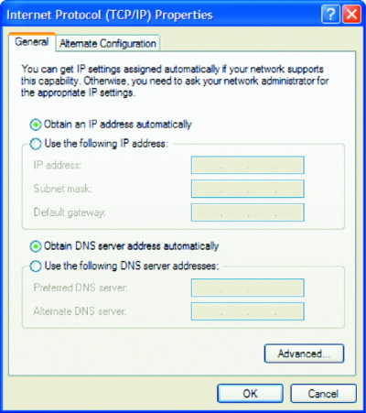
Windows DNS Configuration

Slide 56
Dynamic DNS
DDNS = Dynamic DNS
Used in Website hosting
Manually changing DNS records unmanageable
Process
Service provider runs program on user’s computer
Notifies service provider when IP address changes
Service provider’s server launches routine to automatically update DNS record
Effective throughout Internet in minutes
Not DNS replacement
Larger organizations pay for statically assigned IP address

Slide 57
Application layer protocols

Slide 58
Application Layer Protocols
There are many application layer protocols which work over TCP or UDP plus IP. They translate user requests into a format readable by the network.
We have already talked about 2 Application layer protocols:
HTTP
Application layer protocol central to using Web
DHCP
Automatic address assignment
There are many application layer protocols

Slide 59
Telnet
Terminal emulation protocol
Log on to remote hosts
Using TCP/IP protocol suite
TCP connection established
Keystrokes on user’s machine act like keystrokes on remotely connected machine
Often connects two dissimilar systems
Can control remote host
Drawback
Notoriously insecure

Slide 60
FTP
FTP = File Transfer Protocol
FTP is used to send and receive files via TCP/IP
Host running FTP server portion
Accepts commands from host running FTP client
FTP commands
Operating system’s command prompt
No special client software required
FTP hosts allow anonymous logons
Many graphical FTP clients exist, so command line not necessary.
WS_FTP, CuteFTP, SmartFTP
Web Browsers also often support FTP

Slide 61
TFTP
TFTP = Trivial File Transfer Protocol
Enables file transfers between computers just like FTP, but is simpler (more trivial) than FTP.
TFTP relies on Transport layer UDP
Connectionless
Does not guarantee reliable data delivery
No ID and password required
Security risk
No directory browsing allowed
Useful to load data and programs on diskless workstation

Slide 62
NTP
NTP = Network Time Protocol
Synchronizes network computer clocks
Depends on UDP Transport layer services
Benefits from UDP’s quick, connectionless nature
Time sensitive
Cannot wait for error checking
Time synchronization is important for:
Routing
Time-stamped security methods
Maintaining accuracy, consistency between multiple storage systems

Slide 63
PING
PING = Packet Internet Groper
Provides verification that a device is:
TCP/IP installed, bound to NIC, configured correctly, communicating with network
Host responding
Uses ICMP services
Send echo request and echo reply messages
Determine IP address validity
Ping IP address or host name

Slide 64
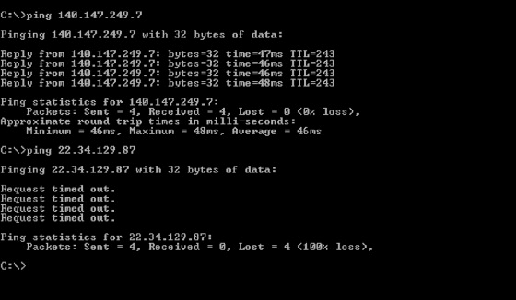
PING Example

